Slide 1
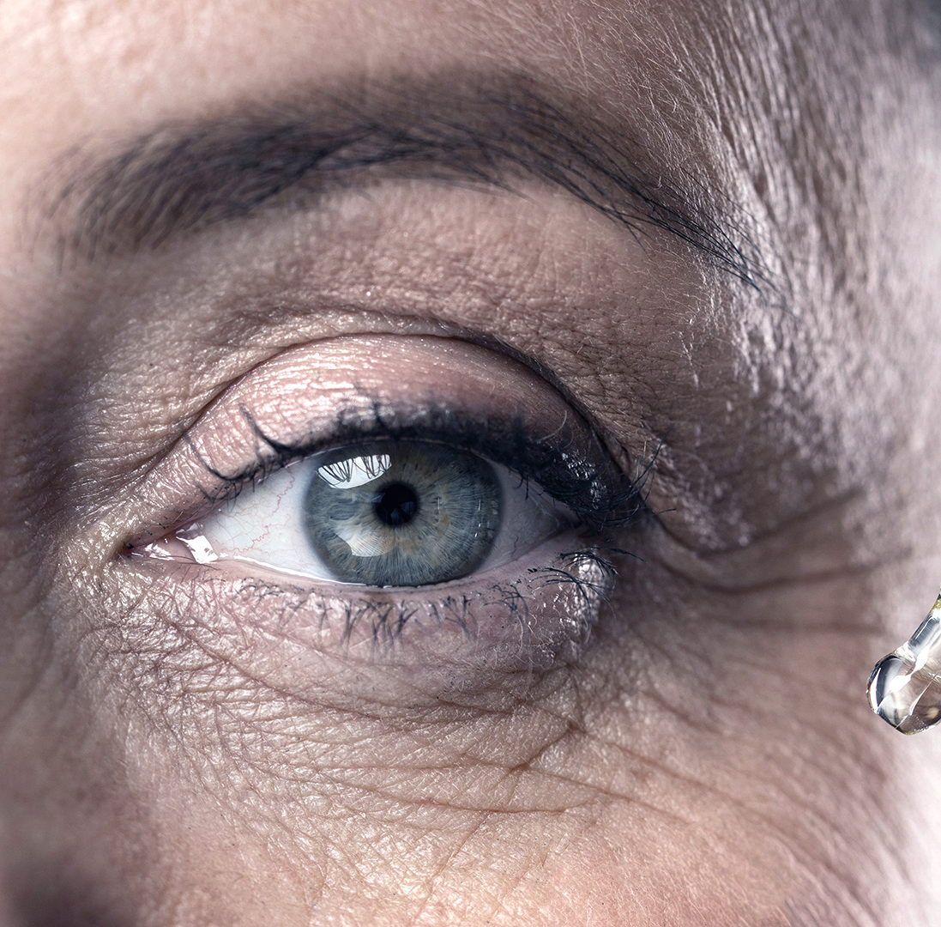
Cure Eye
Non-invasive retinal healthcare

Slide 2
Our Inspiration
Our love of helping others coupled with our love for code has inspired us to make something that can benefit individuals that would otherwise be turned away for proper healthcare. We seek to help prevent millions of deaths every year due
lack of access
lack of skilled professionals
lack of proper equipment

Slide 3
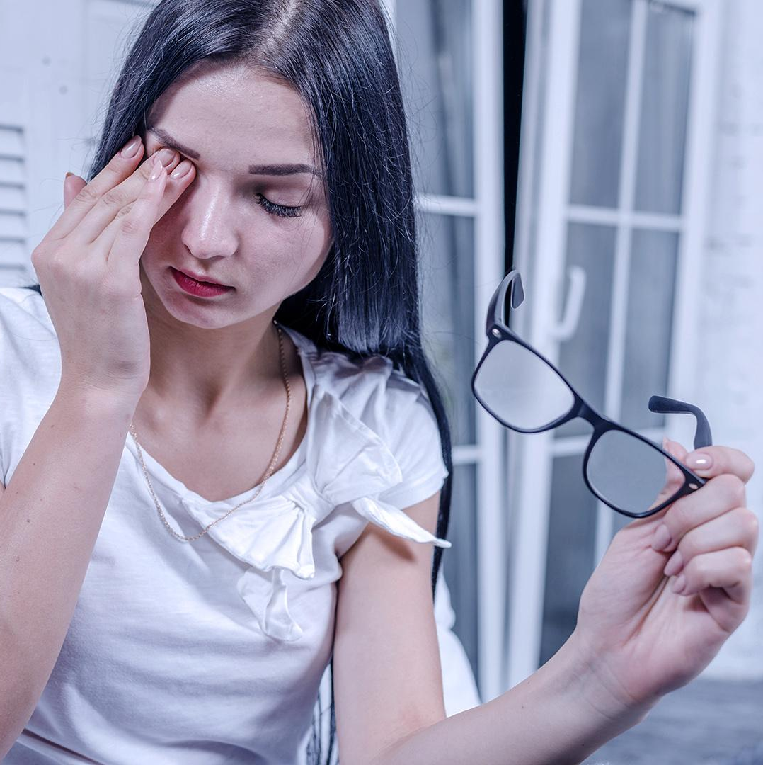
Global Relevance
Diabetic retinopathy is caused by a change in the retina’s blood vessels due to diabetes and is the leading cause of vision loss in adults aged 20–74 years. Through preventative measures of early diagnosis, diabetic retinopathy blindness can be avoided.
According to a study done by Google, deep-learning models using retinal fundus image can predict cardiovascular risk factors that may occur in the next 5 years with accuracy of 72%. This is higher than the typically used method of taking blood tests.
[1]Poplin, Ryan, et al. “Prediction of Cardiovascular Risk Factors from Retinal Fundus Photographs via Deep Learning.” Google Research, Nature, 2018, static.googleusercontent.com/media/research.google.com/en//pubs/archive/46425.pdf.

Slide 4
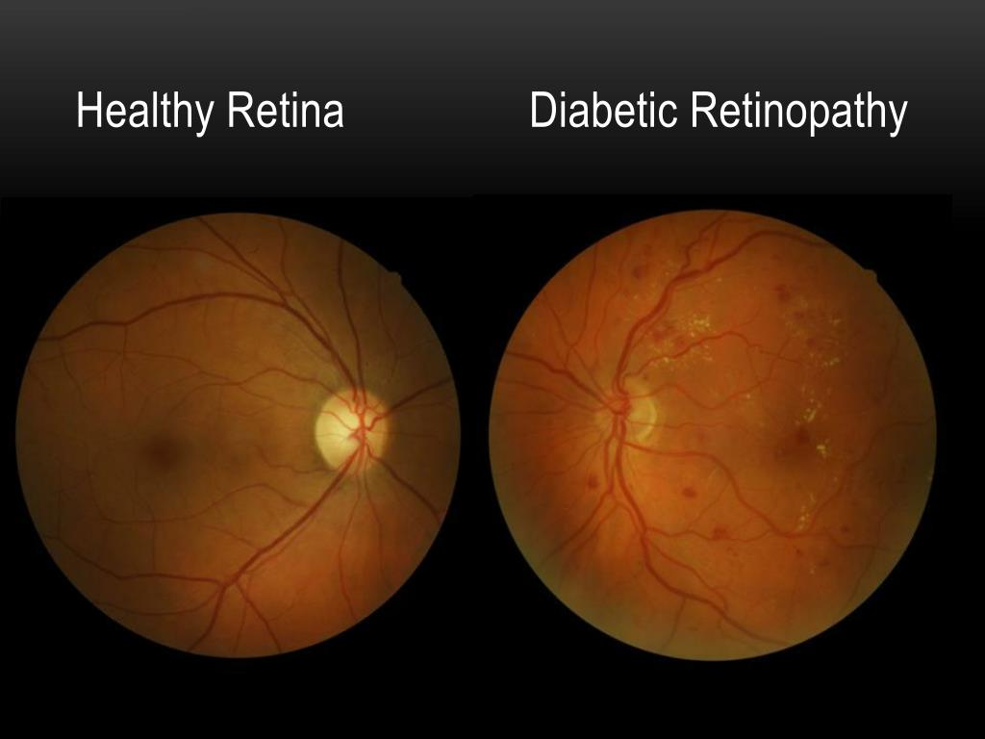
Our Solution
Use machine learning to diagnose patient with just a smartphone camera and model that captures fundus through a colored camera and an IR sensor.

Slide 5
Collection of Images
Low Cost
High Accuracy
Intelligent

Slide 6
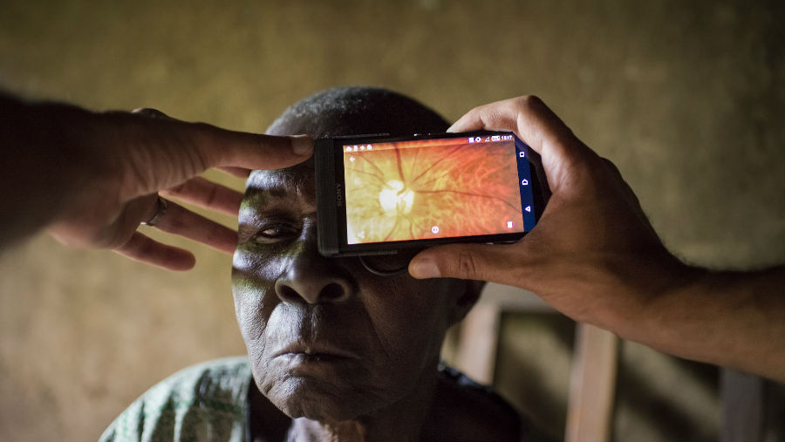
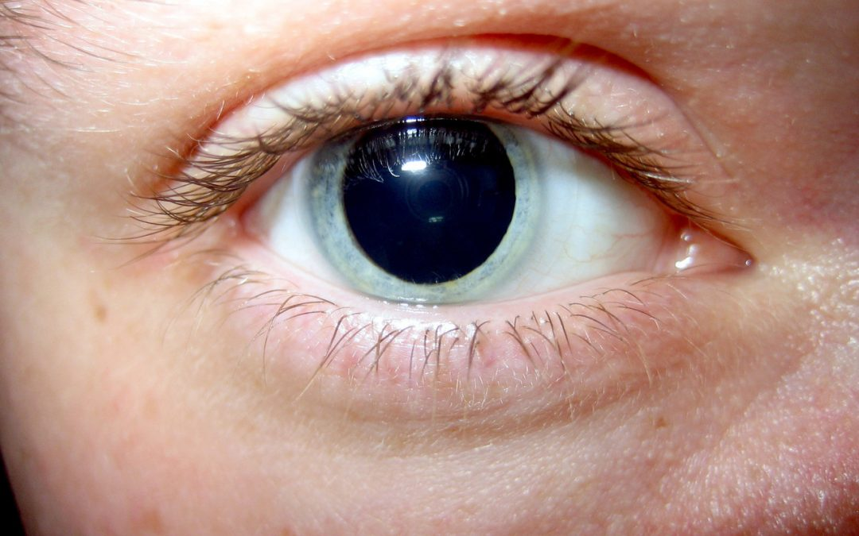
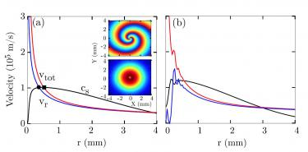
Challenges to Overcome
01
02
03
Unstable Imagery
Dialeted Pupils
Optical Physics

Slide 7
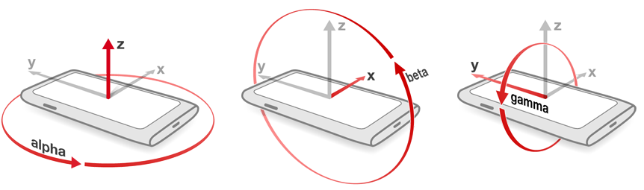
The Challenge
Unstable Camera
Picture Resolution
Viewing Angle
Tactical design of case to increase grip and advises user via built in sensors when not aligned properly
Accelerometer
Gyroscope
Apply several Machine Learning models to stitch images
Stitching of several images of the eye through several frames as if it was a panoramic picture

Slide 8
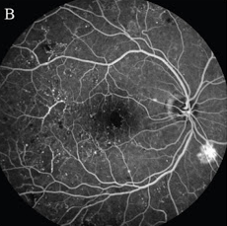
Infrared Image
Machine learning
Machine learning
Machine learning
Machine learning
Result: Disease is Classified

Slide 9
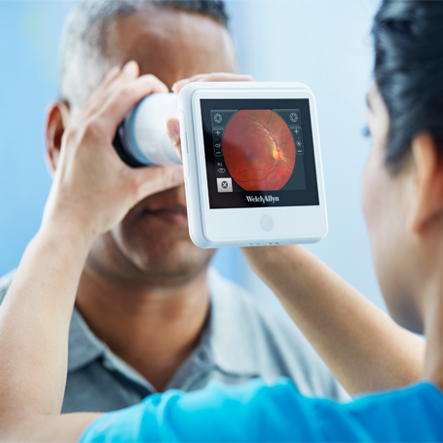
Thanks
TEAM HELIUM
Vashishth Gajjar
Sherelene De Belen
Raghav Dabra
Samarth Arora
Noel Benny
Do you have any questions?

